Slide 1
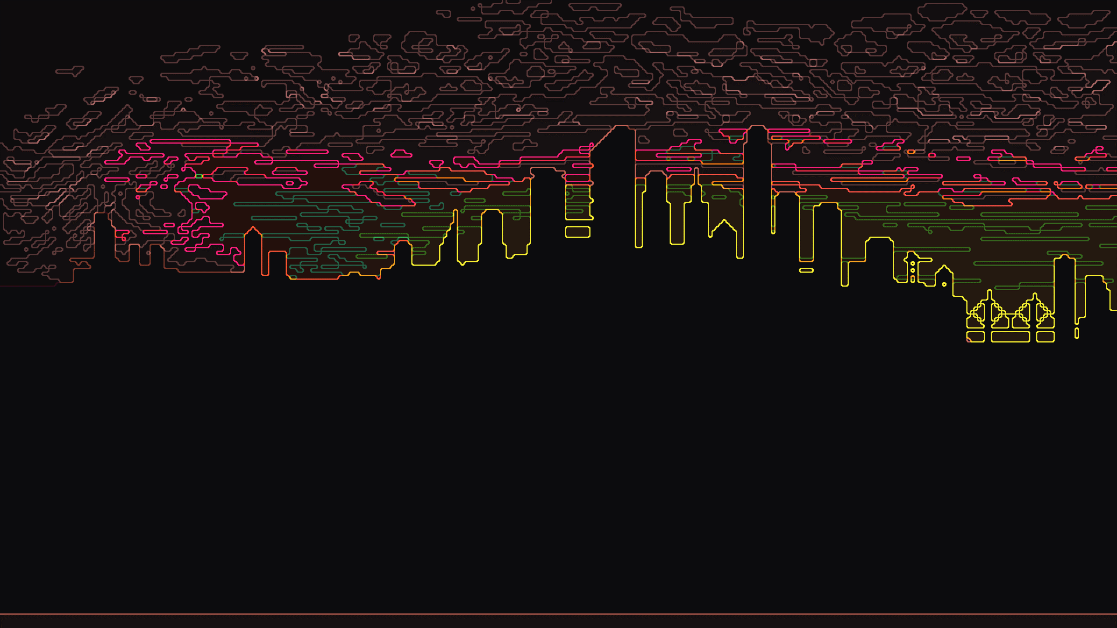
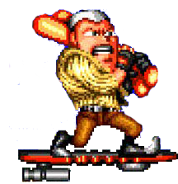

BACK TO THE FUTURE GAME
Creating a Donkey Kong Clone Game
Roshan Thavarajah
Alex Landry

Slide 2
PURPOSE
Playing a Donkey Kong clone where player collects points
Player also has to avoid enemies with his 3 lives

Slide 3
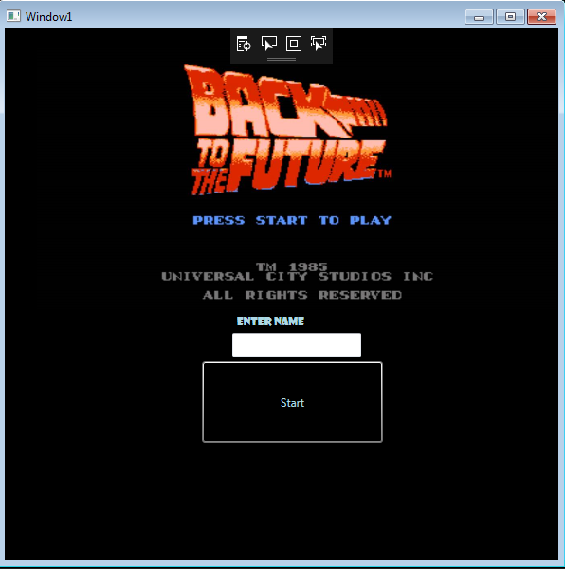
Solution For Start Window
User enters name
Name gets stored in Database
OnButton Click Method

Slide 4
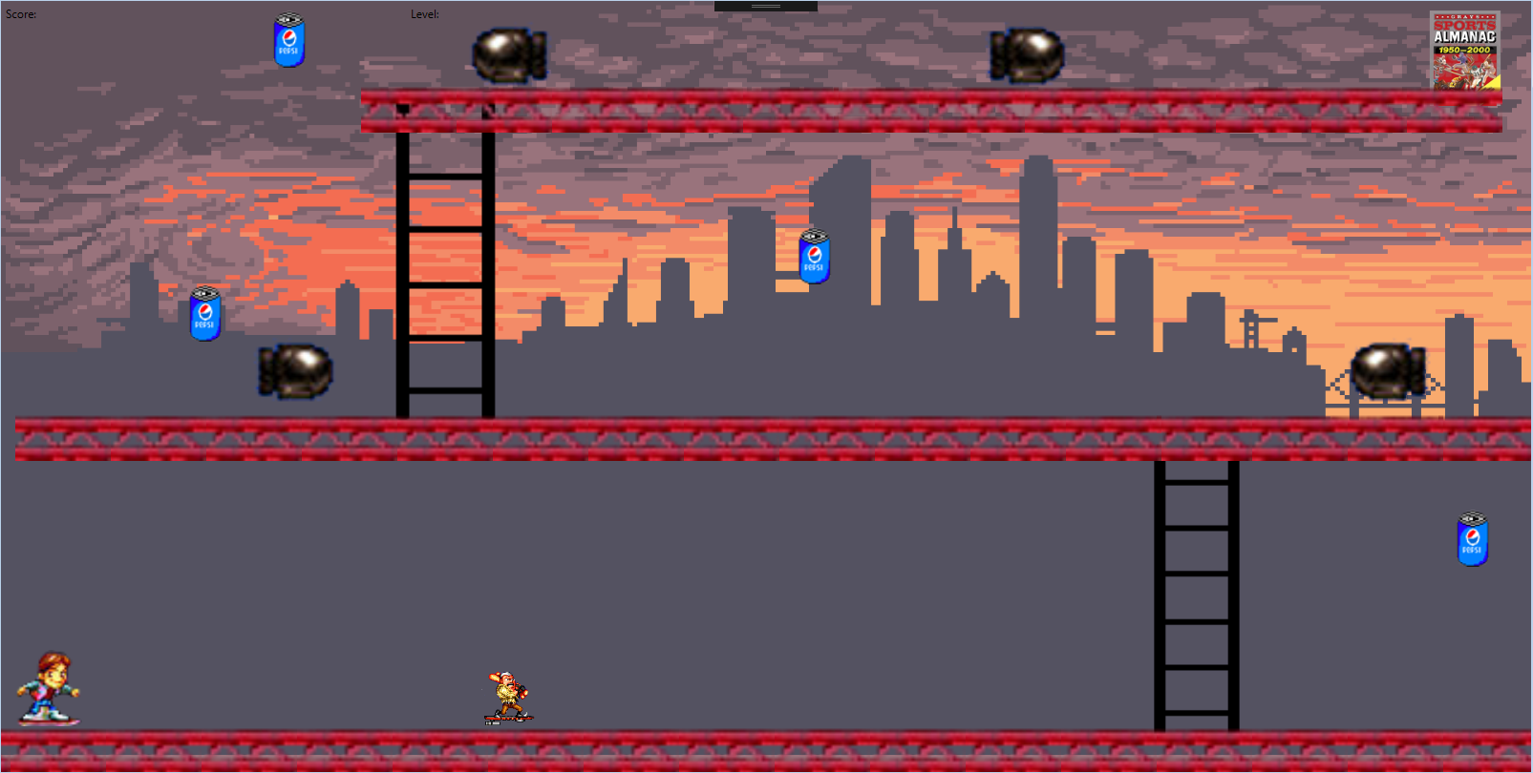
Game Window
Jumping
Collision
Collecting
Winning
Score
Moving
Ladder
Lives

Slide 5
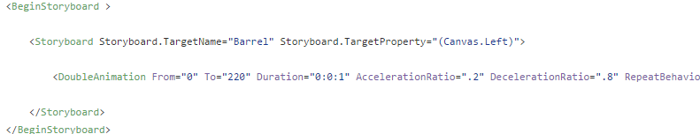
Enemies Movement

Slide 6
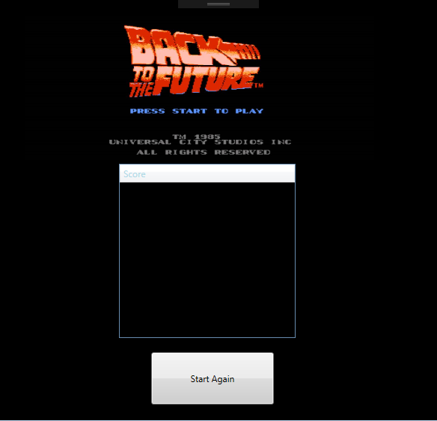
Score Window
Get Name and Score
Set in List Box
Start Again
Database

Slide 7
Collision
Image does not support Intersect
Location doesn't detect size
Reset player
Add points

Slide 8
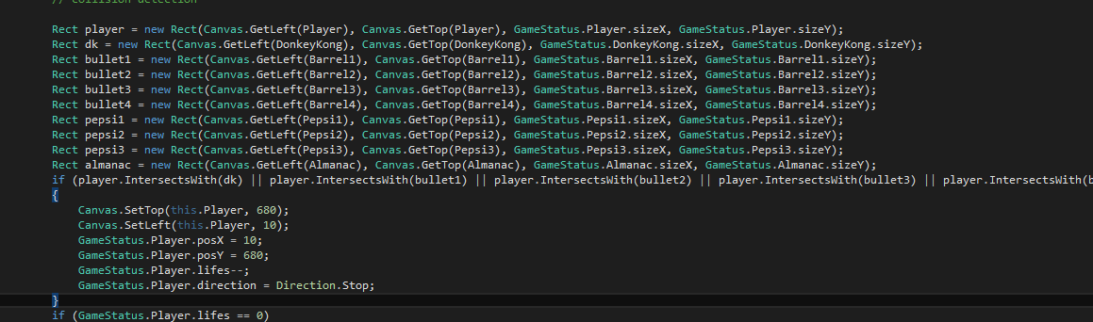
Solved Collision
Rect rect1 = new Rect(Canvas.GetLeft(Player), Canvas.GetTop(Player), GameStatus.Player.sizeX, GameStatus.Player.sizeY);
Rect rect2 = new Rect(Canvas.GetLeft(DonkeyKong), Canvas.GetTop(DonkeyKong), GameStatus.DonkeyKong.sizeX, GameStatus.DonkeyKong.sizeY);
if (rect1.IntersectsWith(rect2)){
ResetPosition(Player)}

Slide 9
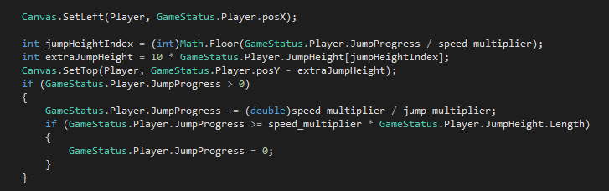
Jumping
public double JumpProgress;
public int[] JumpHeight = new int[10] { 0, 4, 7, 9, 12, 13, 12, 9, 7, 4 };
private int jump_multiplier = 2;
Game Status posY

Slide 10
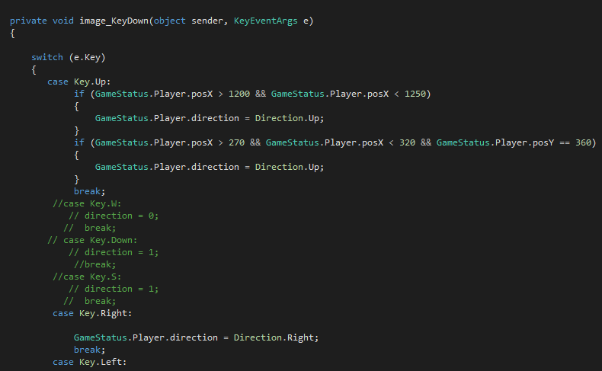
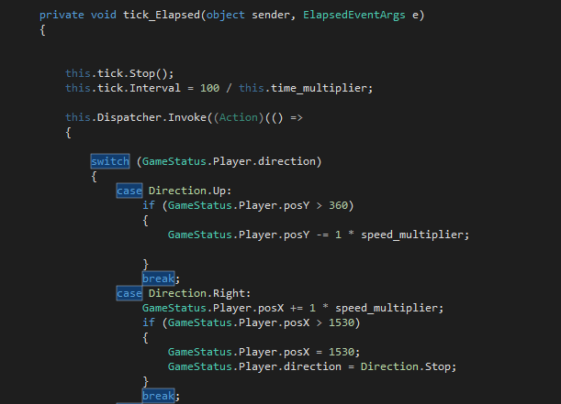
Player movement Solution
case Key.Right:
GameStatus.Player.direction = Direction.Right;
break;

Slide 11
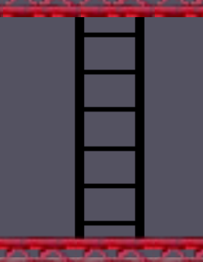
Ladder
Position of ladder
Game Status
Up Key

Slide 12
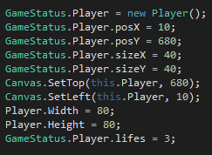
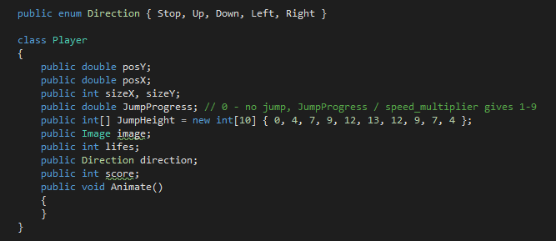
Game Status
Class gameStatus
Position X, Y
Canvas Set top/left

Slide 13
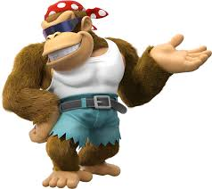
Future Work
More levels
DLC
Ladders
Animation of Characters

Slide 14
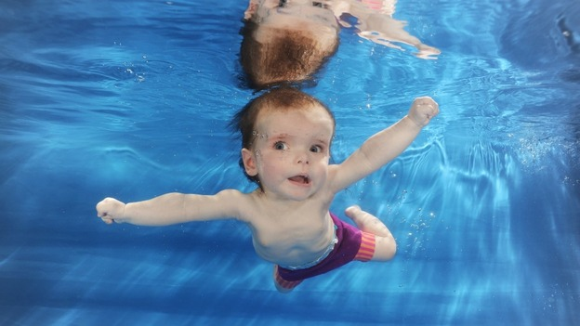
Summary
Wasted One Week on Movement
3 days on collision
2 days on the rest(already over)
WPF Problems

